Slide 1
Docker
Workshop

Slide 2
Virtualization
A Quick Introduction

Slide 3
Moore’s law
What is Docker?
Intel co-founder Gordon Moore is a visionary. His prediction, popularly known as Moore's Law, states that the number of transistors on a chip will double about every two years. Intel and other semiconductor companies kept that pace for over 40 years.
GPU’s performance and functionality have been increasing at a faster pace than Moore’s law.

Slide 4
Technology Advances
What is Docker?
Multi-core: how to fully harness the power of multi-core? Intel has been trying really hard to make us all program for multi-core!!!
Large scale data: How to manage large scale data? Google, Yahoo, NSF and CRA have been promoting their file systems and MapReduce!!
Parallel processing of data: How to configure clusters to process data in parallel?

Slide 5
What is Virtualization
What is Docker?
Virtualization is creation of an alternative to actual version of something:
Virtual memory (more memory than physically available),
Virtual time (buffering provides virtual/effective download time that less than the actual time),
Virtual hardware, desktop, disk, appliances, scenes,
Virtual worlds

Slide 6
What is Virtualization
What is Docker?
In our context it is realizing one or more complete computer systems as guests on the base machine/operating system.
This offers an excellent conduit for delivering the vastly underutilized power of the multi-core and other resources such as storage and devices.

Slide 7
What is Virtualization
What is Docker?
To define it in a general sense,
Virtualization encompasses any technology - either software or hardware - that adds an extra layer of isolation or extra flexibility to a standard system.
Familiar examples include
Virtual memory for memory management,
Virtual disks to allow for partitioning
"virtual machines" (e.g. for of Java and .net) to allow for better software portability.

Slide 8
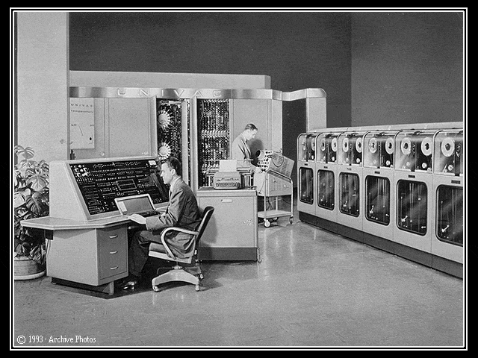
Virtualization History
What is Docker?
Born from Mainframe Technology:
Originally part of mainframe technology, virtualization is not a new concept.
Mainframes started as very large computers in the 1960s to process compute tasks.

Slide 9
Virtualization on a Mainframe
What is Docker?
Mainframe Virtualization:
Concept was to split the computer into multiple virtual machines so different “tasks” can be run separately and independently on the same mainframe.
If one virtual machine or “task” has a problem, other virtual machines are unaffected
VM #1
Task A
VM #2
Task B
VM #3
Task C
VM #4
Task D
VM #5
Task E
VM #6
Task F
VM #7
Task G
Mainframe Sample Diagram

Slide 10
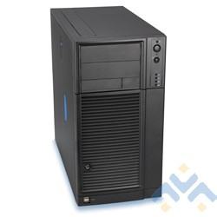
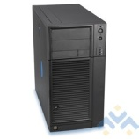
Computers in 1990s
Fast Forward to the 1990s
Intel/AMD servers now very popular (known as “x86” servers)
Each server runs Operating Systems such as Microsoft, Linux, or Netware
Companies put ONE operating system & ONE application on each server
2 servers would grow to 6 servers, eventually to 50 or more servers!
Electricity and space (footprint) becomes a problem….
What is Docker?
File
Server
File
Server
File
Server
Web
Server
Web
Server
Domain
Server
DNS
Server
Each Server Running
1 Application
App
Server

Slide 11
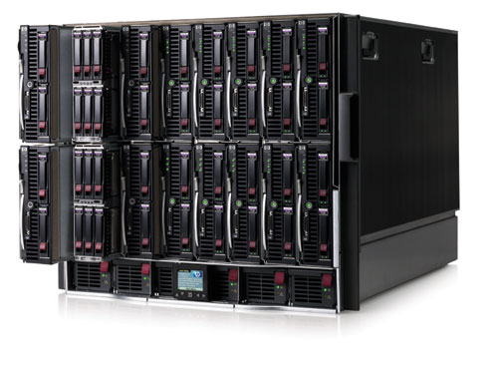
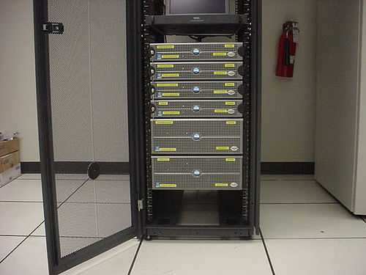
Computers in 2000s
What is Docker?
Fast Forward to the 2000s
Manufacturers “to the rescue”!
Focus on making servers small
“Rack” form factors (6-20 servers per cabinet)
“Blade” form factors (30-60 servers per cabinet)
Space/footprint problem helped….some
Electricity and heat still a problem
As Servers Got Faster…
Server utilization became even lower
Average server utilization ranges between 4 -10%
STILL one application per server
Example HP “Blade” Servers
Example Dell “Rack” Servers

Slide 12

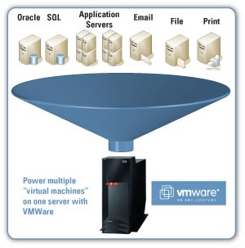
Virtualization is the Key
Apply Mainframe Virtualization Concepts to Intel / AMD Servers:
Use virtualization software to partition an Intel / AMD server to work with several operating system and application “instances”
What is Docker?
Oracle
SQL
Application Servers
Email
File
Print
DNS
Domain
Deploy several “virtual machines”
on one server using groundbreaking virtualization software

Slide 13
Traditional Physical Server
What is Docker?
Traditional x86 Server Architecture
Single operating system per machine
Single application per machine
Hardware components connected directly to operating system
CPU
Memory
Disk
Network Card
Application
Operating System
x86 Architecture
CPU
Memory
Disk
Network
1 Physical Server, 1 Application

Slide 14
New Architecture: Virtual Server
What is Docker?
Virtualization Layer
Addition of a virtualization layer called a “hypervisor”
Several servers can be deployed as Virtual Machines (VM) on each physical box
Each VM has its own operating system and application
Can run multiple, different operating systems on the same machine
If one VM fails, other VMs are unaffected
Application
Application
Application
Microsoft
OS
Linux
OS
Microsoft
OS
CPU (s)
vDisk
CPU (s)
vDisk
CPU (s)
vDisk
Memory
vLAN
Memory
vLAN
Memory
vLAN
Virtualization Layer (Hypervisor)
x86 Architecture
CPU
Memory
Disk
Network
3 Virtual Servers on 1 Physical Server

Slide 15
Virtualization Layer Explored
What is Docker?
Virtualization Layer – Compatibility
A virtual machine is compatible with standard x86 operating systems such as Windows and Linux
A virtual machine has a motherboard, cpu, memory, disk and network just like a physical server
Applications developed for the standard OS’s will work on a virtual machine
No adjustments are needed to run applications on virtual servers

Slide 16
Virtualization Layer Explored
What is Docker?
Virtualization Layer - Isolation
Virtual machines on the same physical machine run independently
They are protected from each other

Slide 17
What is Hypervisor?
What is Docker?
“Hypervisor is a software layer sits between Hardware and OSes which will interact with hardware and resources and provide an interface to share the available resources to Virtual containers.”

Slide 18
Hypervisor-based virtualization
What is Docker?
Technologies that fall into this category can be divided into two basic types:
Type 1 (or native, bare-metal) hypervisors
are software systems that run directly on the host's hardware to control the hardware and to monitor guest operating-systems.
A guest operating system thus runs on another level above the hypervisor .
Type 2 (or hosted) hypervisors
are software applications running within a conventional operating-system environment.
Guest operating systems thus run at the third level above the hardware.
.

Slide 19
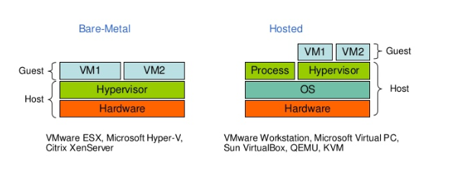
Hypervisor-based virtualization
What is Docker?

Slide 20
OS virtualization
What is Docker?
Instead of simulating an entire set of hardware, the existing OS is "partitioned" to cater to several isolated applications that are all operating under the impression that they have sole control of the OS.
Though this remains restricted to the use of one kernel, the partitions can use different distributions and/or drivers and run completely independently.
Advantage : the amount of overhead created on the host system is greatly reduced compared to hardware virtualization, as there is no need to maintain a complete set of hardware for each partition.

Slide 21
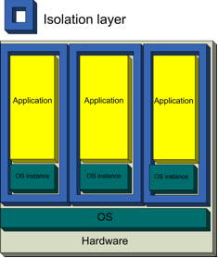
OS virtualization
What is Docker?
Examples :
Linux-based systems: OpenVZ

Slide 22
OS virtualization
What is Docker?
Every partition has its own network address and its own set of login credentials, system processes and daemon services.
Because the underlying operating system is always running, each partition can be rebooted independently and data can be migrated from one virtual environment to another on a live host.

Slide 23
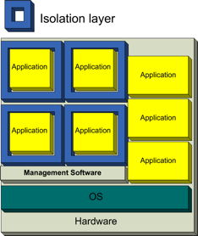
Application virtualization
What is Docker?
Applications are turned into isolated, self-contained packages that are able to operate under an OS and use all of its resources.
Because the packages are basically a complete environment they no longer require installation, thus providing extremely easy software distribution along with the safety of a completely isolated application.
Examples : the Common Language Runtime environment of the .NET Framework and the Java Virtual Machine.

Slide 24
Virtual Machines Explored
What is Docker?
Virtual Machines
A virtual machine is a collection of software that has been translated into files
These files are collected and organized in “containers”
These containers can be moved in seconds from one physical machine to another in case of physical server failure or performance needs.
Virtual machines have all the same hardware resources available such as CPU, memory, disk, and network

Slide 25
Virtualization Benefits
What is Docker?
Consolidation
Redundancy
Legacy hardware
Migration
Centralized management

Slide 26
Docker Overview
An Quick Introduction

Slide 27
What is Docker?
What is Docker?
Docker is an open-source project that automates the deployment of applications inside software containers, by providing an additional layer of abstraction and automation of operating system–level virtualization on Linux.
[Source: en.wikipedia.org]

Slide 28
Market View: Evolution of IT
What is Docker?
1995
2015
Thick, client-server app on thick client
Thin app on mobile, tablet
Well-defined stack:
O/S
Runtime
Middleware
Assembled by developers using best available services
Running on any available set of physical resources (public/private/ virtualized)
Monolithic Physical Infrastructure

Slide 29
Challenges

Slide 30
The Challenge

Slide 31
Results in N X N compatibility nightmare

Slide 32
The Analogy

Slide 33
Also an NxN Matrix

Slide 34
Solution: Intermodal Shipping Container

Slide 35
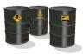
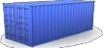
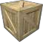
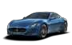


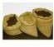

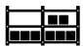
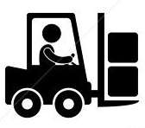
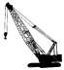



This eliminated the NXN problem…

Slide 36
Spawned an Intermodal Shipping Container Ecosystem

Slide 37
Docker is a shipping container system for code

Slide 38
Or…put more simply

Slide 39
Docker solves the NXN problem

Slide 40
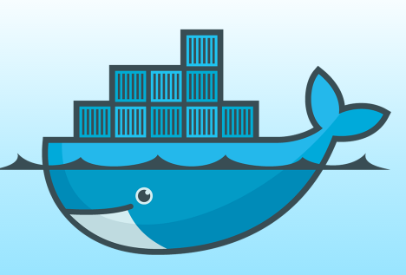
What is Docker?
Docker: Name
Provide a uniformed wrapper around a software package: «Build, Ship and Run Any App, Anywhere»
Similar to shipping containers: The container is always the same, regardless of the contents and thus fits on all trucks, cranes, ships, ...
[www.docker.com]

Slide 41
What is Docker?
What is Docker?
Docker is an open-source project that automates the deployment of applications inside software containers, by providing an additional layer of abstraction and automation of operating system–level virtualization on Linux.
[Source: en.wikipedia.org]

Slide 42
Why Developers Care

Slide 43
Why Devop’s Cares?

Slide 44
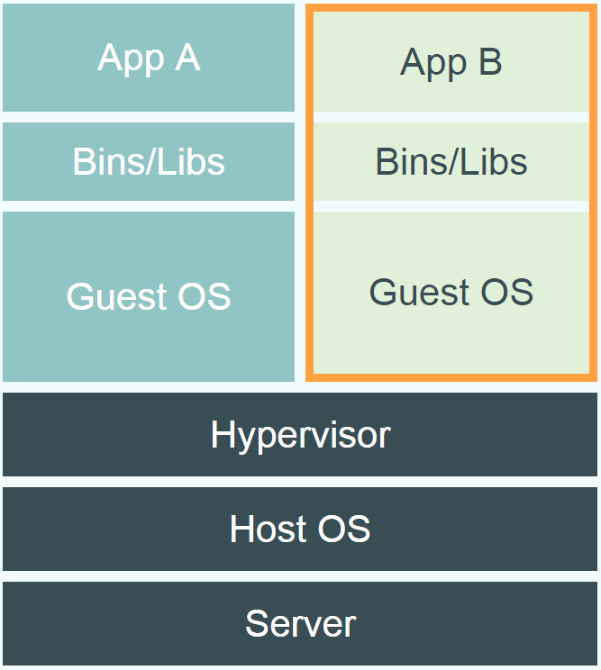
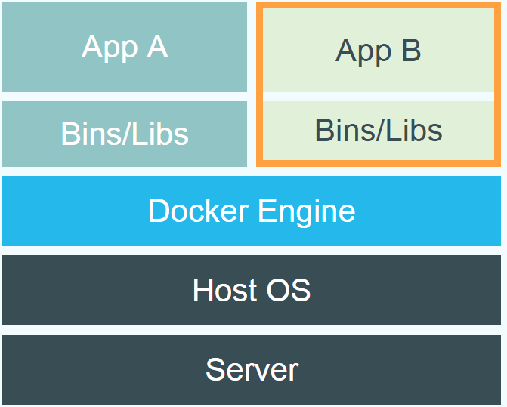
Docker Vs VM
Docker vs. Virtual Machine
Source: https://www.docker.com/whatisdocker/
Notes:
Virtual Machines
Each virtualized application includes not only the application - which may be only 10s of MB - and the necessary binaries and libraries, but also an entire guest operating system - which may weigh 10s of GB.
Docker
The Docker Engine container comprises just the application and its dependencies. It runs as an isolated process in userspace on the host operating system, sharing the kernel with other containers. Thus, it enjoys the resource isolation and allocation benefits of VMs but is much more portable and efficient.
Docker provides base images that contain OS installations we can start from: The OS is not more than an application running on the Kernel...

Slide 45
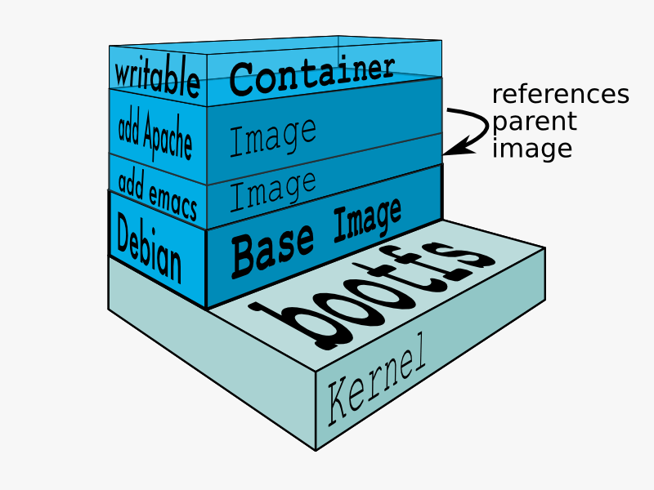
Containers
Docker Technology
libvirt: Platform Virtualization
LXC (LinuX Containers): Multiple isolated Linux systems (containers) on a single host
Layered File System
[Source: https://docs.docker.com/terms/layer/]

Slide 46
Containers
Containers are operating system level virtualization
Allows for multiple isolated user space instances called containers
They share a single kernel
Can be added or removed at any time
Containers consist of a self contained Linux file system
Can be from any Linux distribution which is compatible with the host kernel
Usually contain a single application such as a server
Operating system level virtualization is lightweight
Is often used in Cloud Computing

Slide 47
Architecture
Docker uses a client-server architecture
Client
a REST API Client
Over HTTP
Over local Unix socket
Server
Is the Docker daemon
Responsible for building, running, and distributing containers
Registry
Responsible for the storage, management, and delivery of Docker Images
Docker Hub
Private
Other vendors

Slide 48
Docker Image
Terminology - Image
Persisted snapshot that can be run
images: List all local images
run: Create a container from an image and execute a command in it
tag: Tag an image
pull: Download image from repository
rmi: Delete a local image
This will also remove intermediate images if no longer used

Slide 49
Docker Container
Terminology - Container
Runnable instance of an image
ps: List all running containers
ps –a: List all containers (incl. stopped)
top: Display processes of a container
start: Start a stopped container
stop: Stop a running container
pause: Pause all processes within a container
rm: Delete a container
commit: Create an image from a container
Notes:
docker run --rm to remove container after termination

Slide 50
Lifecycle - Image vs. Container
Base Image
nginx:latest
run
Container
cid1
base image
cmd → new state
New Image
iid1
commit
Container
cid1
run
Container
cid2
Container
cid3
Container
cid4

Slide 51
Dockerfile
Dockerfile
Create images automatically using a build script: «Dockerfile»
Can be versioned in a version control system like Git or SVN, along with all dependencies
Docker Hub can automatically build images based on dockerfiles on Github

Slide 52
Example
Dockerfile Example
Dockerfile:
FROM busybox:latest CMD ["date"]
docker build [DockerFileDir]
docker inspect [imageId]
Notes:
docker run -ti d97 /bin/bash
testFile.txt -> present
set -> env Variable PROVIDER set
docker run –P -d d97

Slide 53
Volumes
Mount Volumes
docker run –ti –v /hostLog:/log ubuntu
Run second container: Volume can be shared
docker run –ti --volumes-from firstContainerName ubuntu
Notes:
Use docker start, docker attach to reuse container
Change script to echo ... >> /log/hello3.log

Slide 54
Summary
Docker Architecture
Notes:
Automatically build a Docker image on Docker-Hub:
Example: playground-docker-echoey in Bitbucket: https://bitbucket.org/inftec/playground-docker-echoey/overview
Automated Build Repository on Docker Hub: https://registry.hub.docker.com/u/pazoozoo/playground-docker-echoey/
Build took around 5 minutes...
Run on AWS Elastic Beanstalk:
Need to ZIP Dockerfile and dependencies (ADD files)
Beanstalk environment expects HTTP service on first EXPOSEd port though → not working with dummy echo service

Slide 55
Docker Mind Map
Notes:
Automatically build a Docker image on Docker-Hub:
Example: playground-docker-echoey in Bitbucket: https://bitbucket.org/inftec/playground-docker-echoey/overview
Automated Build Repository on Docker Hub: https://registry.hub.docker.com/u/pazoozoo/playground-docker-echoey/
Build took around 5 minutes...
Run on AWS Elastic Beanstalk:
Need to ZIP Dockerfile and dependencies (ADD files)
Beanstalk environment expects HTTP service on first EXPOSEd port though → not working with dummy echo service

Slide 56
Docker Compose
Docker Compose is a tool for running multi-container Docker applications
A configuration file is used to define the services
All of the services can be run using a single command
Compose can manage the lifecycle of an application
Start, stop, and rebuild services
View the status of running services
Get the log output of running services
Run a command on a service

Slide 57
Questions?

